Slide 1
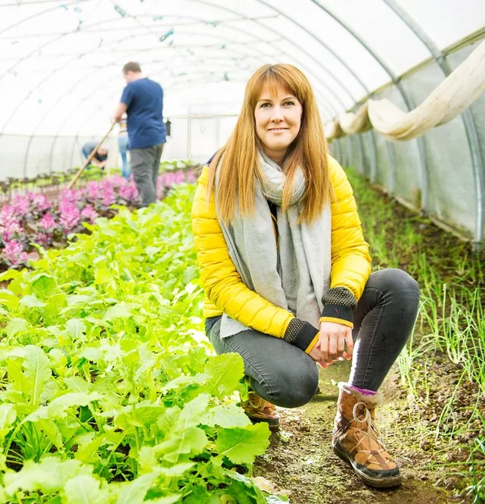
ACTIVATE WEBINAR
9 April 13:00-14:00
Mary Smith (CF 2019), Activate 2022
Collaborated with national experts and co-designed a formal delivery framework for mental health care farms in the UK
Scott Hawley, CF 2024 (CHANGE)
Welsh Laverbread:
A Recipe for Resilient UK Coastal Economies?

Slide 2
What we'll cover today
How we got here
Key information
Eligibility and application process
Support available
Insights from the Activate pilot by Amy
Your questions
We are recording this webinar, and we will put the link on our website shortly so you can listen again.
If you have a question after the event, please email activate@churchillfellowship.org

Slide 3

How we got here
To support the impact Fellows are making in their communities and sectors, the Activate Fund launched as a pilot scheme running from 2020–2024. Across three years, the Fund awarded £1.2 million to 50 Fellows, to support them in turning their ideas into action.
Fellows used the funding for a range of things, including the early-stage development of ideas and organisations, evaluation and research, and influencing change on key social issues. You can find out more about the pilot and get inspiration on our website.
The Activate Fund has been shaped by the success and learnings
of the pilot, aiming to provide Fellows with flexible funding and
support to accelerate their journey towards change.

Slide 4
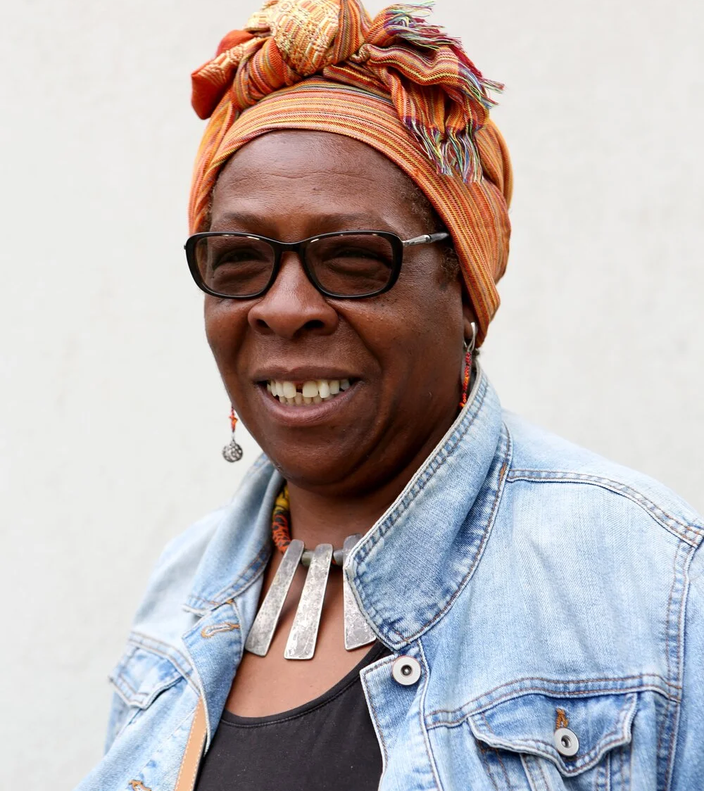
Activate Fund 2026
Grants for Fellows of up to £30,000 for a project of up to 2 years.
20 grants available in 2026.
Fund will remain open for at least five years, with more awards being made in each year.
Grants can support time/salaries, care costs, participation, materials, and resources.
Additional support programme.
Yvonne Field (CF 2012), Activate 2022
Captured learning of intergenerational leaders and developed resources to facilitate knowledge exchange
Abdullah Geelah, CF 2018
The socio-spatial role of mosques in shaping a cohesive identity

Slide 5
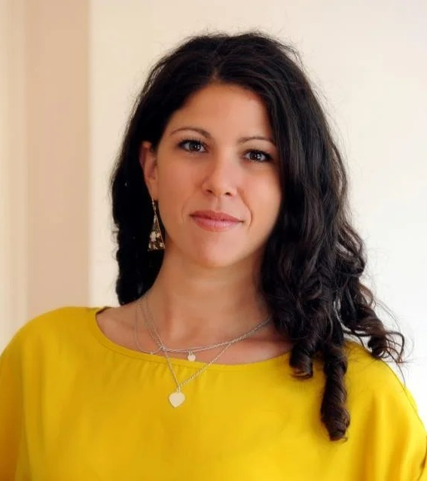
Who can apply?
Any Fellow who:
Has completed and shared learning
Is based in the UK
Has not received an Activate grant during the pilot scheme
Fellows can apply as an individual, through an organisation, or with a group of Fellows
Esther Foreman (CF 2013), Activate 2021
Developed a service to ensure community groups are held accountable by their communities and respond to evolving needs

Slide 6
Individual
Grant will be held and paid out to you.
As part of an organisation
You must play a leading role in the delivery of project.
You will still be personally responsible for the grant.
If you leave the organisation during your grant period, you will need to demonstrate how you will remain involved in the project.
Group
One Fellow must lead and hold the grant.
All group members will be invited to attend interviews.

Slide 7
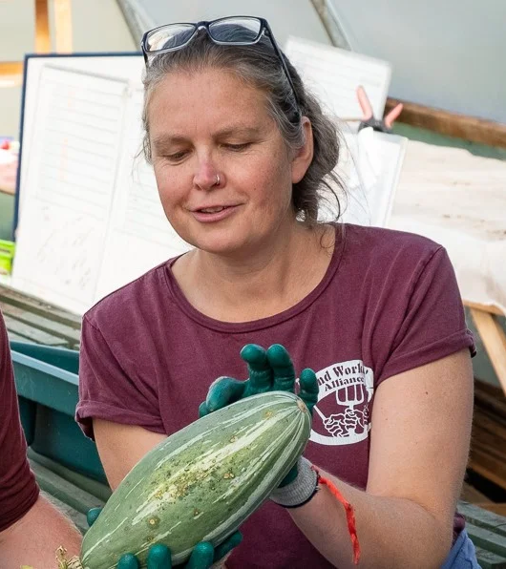
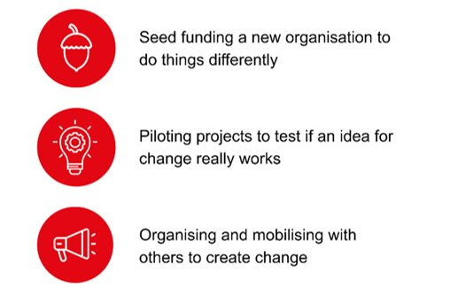
What can you do with an Activate grant?
Activate is designed to support Fellows wishing to create change in their chosen field, through one of the three pathway routes to change:
Kerry Cressey, CF 2020​
Refugee language learning and integration through host communities
Abdullah Geelah, CF 2018​
The socio-spatial role of mosques in shaping a cohesive identity
Helen Woodcock (CF 2010), Activate 2021
Worked to establish a pioneering community-owned farm
Herbert Klein, CF 2020
Improving Emergency Services for Deaf People
Notes:
Add 3 change routes here?

Slide 8
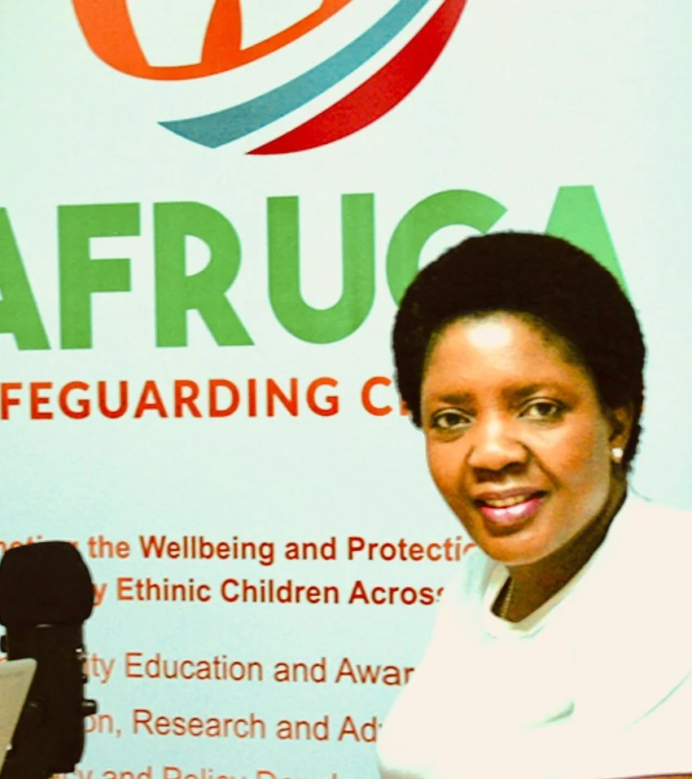
Building capacity and infrastructure to do things differently
This could be for a new or emerging organisation, or a new or evolving partnership or programme that responds to unmet or inadequately met needs.
If your project requires match-funding, this does not have to be secured when you apply, but we will want to understand more about your plans for sustaining what Activate enables you to start.
Debbie Ariyo (CF 2019), Activate 2022
Piloted a residential capacity-building programme for 15 anti-trafficking innovators from minoritised racial groups across the UK

Slide 9
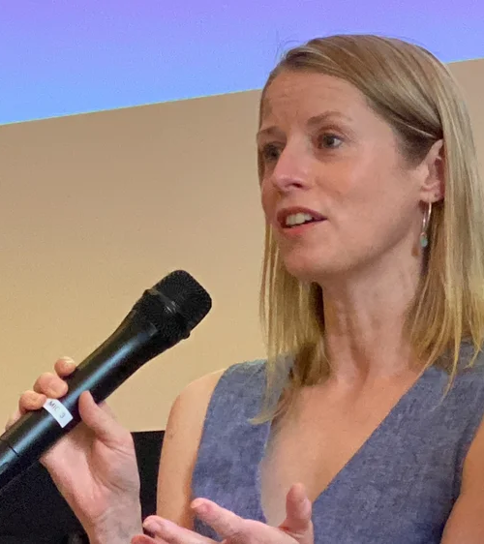
Piloting projects to test if an idea for change really works
This could be by piloting new approaches to deliver a service, model or intervention, either at local, regional, or national level, or with a particular community.
The aim is to test that the idea really works in practice, to build an evidence base, to engage key stakeholders in participating in delivery and supporting wider adoption.
Ceinwen Giles (CF 2013), Activate 2022
Designed and delivered a pilot programme targeting the psychological needs of young adults transitioning into mainstream adult cancer services
Abdullah Geelah, CF 2018​
The socio-spatial role of mosques in shaping a cohesive identity
Kerry Cressey, CF 2020​
Refugee language learning and integration through host communities
Herbert Klein, CF 2020
Improving Emergency Services for Deaf People
Notes:
Add 3 change routes here?

Slide 10
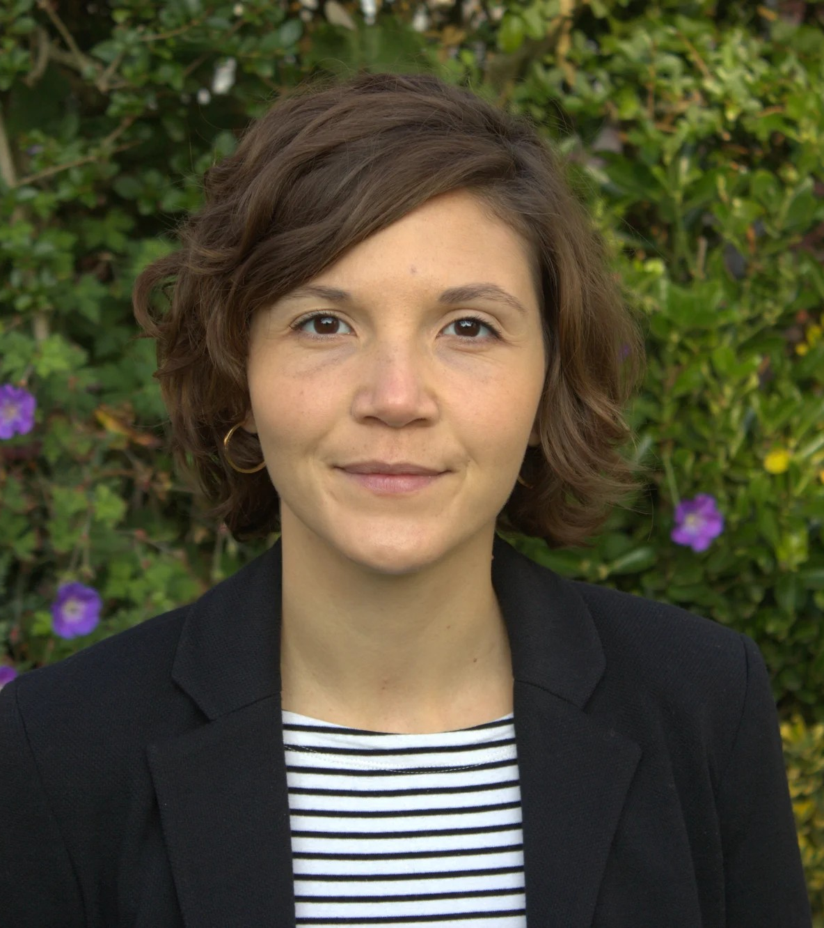

Organising and mobilising with others to create change
National or local campaigning for policy or legislative change
Further publication or events to disseminate and promote your Fellowship recommendation
Community organising
Bringing networks and alliances together to build a momentum for change
Amanda Walters (CF 2018), Activate 2022
Piloted a campaign to change national policy on sick pay

Slide 11








Universal themes
Choose the theme that is most relevant to your project idea and the change you want to see.
Arts and culture
Community and citizenship
Economy and enterprise
Environment and resources
Education and skills
Governance and public provision
Health and wellbeing
Science and technology

Slide 12
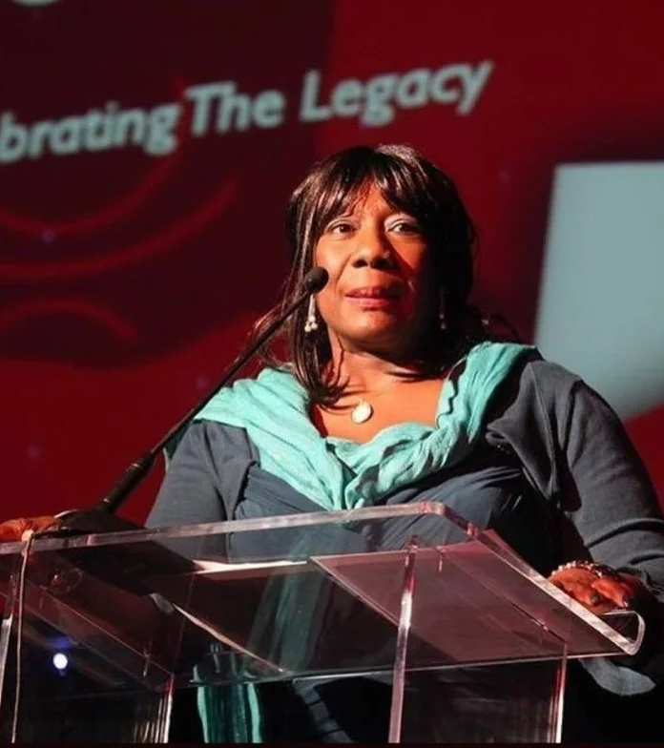
Good to know
Your project does not need to be within the same sector as you Fellowship, as long as this builds on what you have learnt during your Fellowship.
We will prioritise awarding grants to applications from Fellows who would find it difficult to find funding elsewhere.
We will also prioritise projects which are particularly innovative, experimental, or groundbreaking.
We are looking for ideas that are 'ready to go'.
A grant from the Active Fund may affect your tax or benefits status.
Gee Walker (CF 2012), Activate 2021
Expanded her Foundation’s service model to incorporate different types of therapy to support victims of hate crime
Herbert Klein, CF 2020
Improving Emergency Services for Deaf People

Slide 13
How to apply
Read our guidance and FAQ's.
All eligible Fellows should have received a warm-up email on 1 April.
You will receive another email from us on 15 April, with instructions on how to apply and an application link.
You may need to provide additional information if you are applying as a group or as part of an organisation or if you are working with children or adults at risk.
Complete your application by midday on 22 June

Slide 14

Key application questions
How does your project relate to your Fellowship?
Why is your project needed and why is it needed now?
How would an Activate grant make a difference to your ability to carry out a project?
Who will benefit most and what difference do you aim to make?
What do you hope might have changed because of your work and how will you know?
David Stanley (CF 2019), Activate 2022
Expanded the work of The Music Man Project and raised its profile across government, private sectors, and cultural sectors in the UK
Herbert Klein, CF 2020
Improving Emergency Services for Deaf People

Slide 15
What makes a strong application
A credible connection with Fellowship learning.
A clear vision for change that fits comfortably into one of the three routes for change.
Strong rationale for why the funding is needed and evidence that there is momentum behind the idea.
It is clear how beneficiaries of the project are involved in the design and delivery.
Realistic plans, achievable goals, and a clear delivery plan that includes evaluation plans, with thought given to the sustainability of the project beyond the life of the grant.

Slide 16
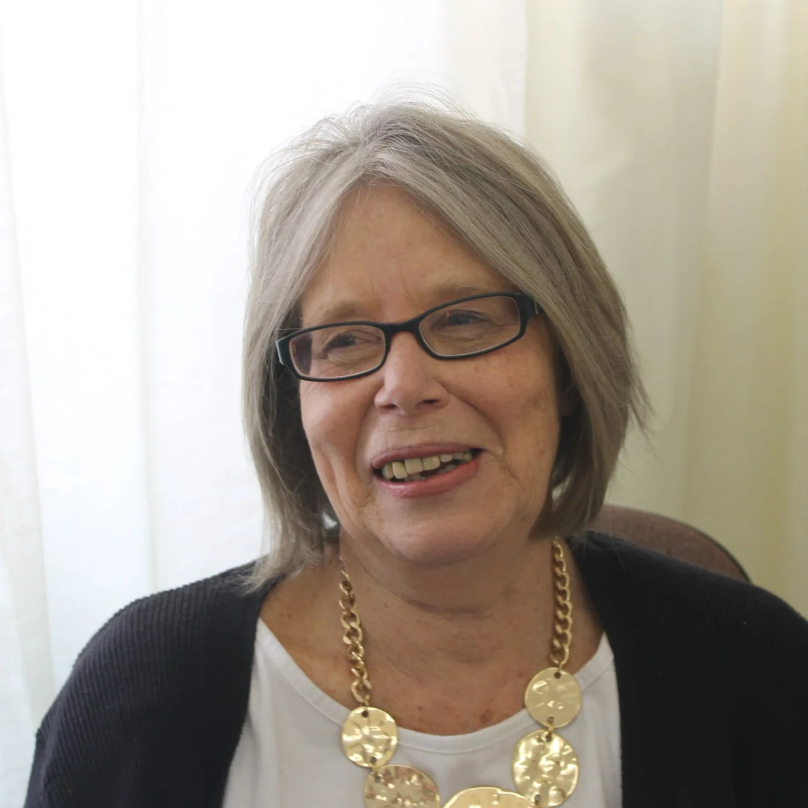
Application timeline
1 April 2026
Warm-up email
15 April - 22 June
Application window
Mid-August
Longlist email
Mid-September
Shortlist and interview email
23 September
Interview webinar
5 – 9 October 2026
Interviews
19 October 2026
Outcome email
January 2027
Celebration event
Ann Pascoe (CF 2012), Activate 2020
Set-up and ran a pilot programme to support carers in rural areas in the Scottish Highlands and connect them to their communities
Jason Williams, CF 2024 (CHANGE)
Improving greenspaces in urban areas

Slide 17
How we can support you to apply
Webinars on 9 April and 29 April
Guidance and FAQs
Interview webinar on 23 September
If applying using the online form is difficult, there are other ways, including:
Word version
Audio recording
Working with a scribe
activate@churchillfellowship.org 020 4604 4589

Slide 18
How we can support throughout your grant
We are developing a support offer for Fellows throughout their Activate grant. We intend for this offer to be flexible, responsive, and purposeful. This could include:
Quarterly check-ins
Practical support and resources
Peer support sessions / networking
The support offer will continue to evolve throughout the programme as we continue to learn alongside Fellows.

Slide 19
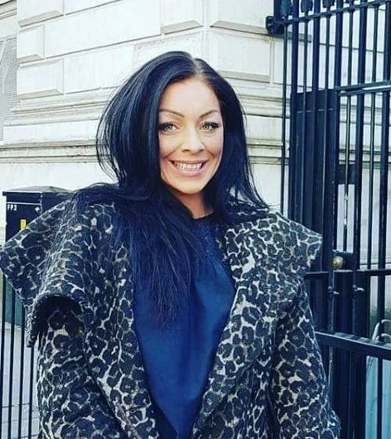
Insights from the Activate pilot and top tips from Amy Varle (CF 2016)
Amy Varle (CF 2016), Activate 2020
Set up a 'mastermind' group of cross-sector practitioners who can come together and deliver best practice models for reducing homelessness across the UK
Read more about Amy's Activate journey here.

Slide 20
Links and contact details
Guidance for applicants
Frequently asked questions (FAQs)
Stories from the Activate Pilot 2020 - 2024
activate@churchillfellowship.org
020 4604 4589

