Slide 1
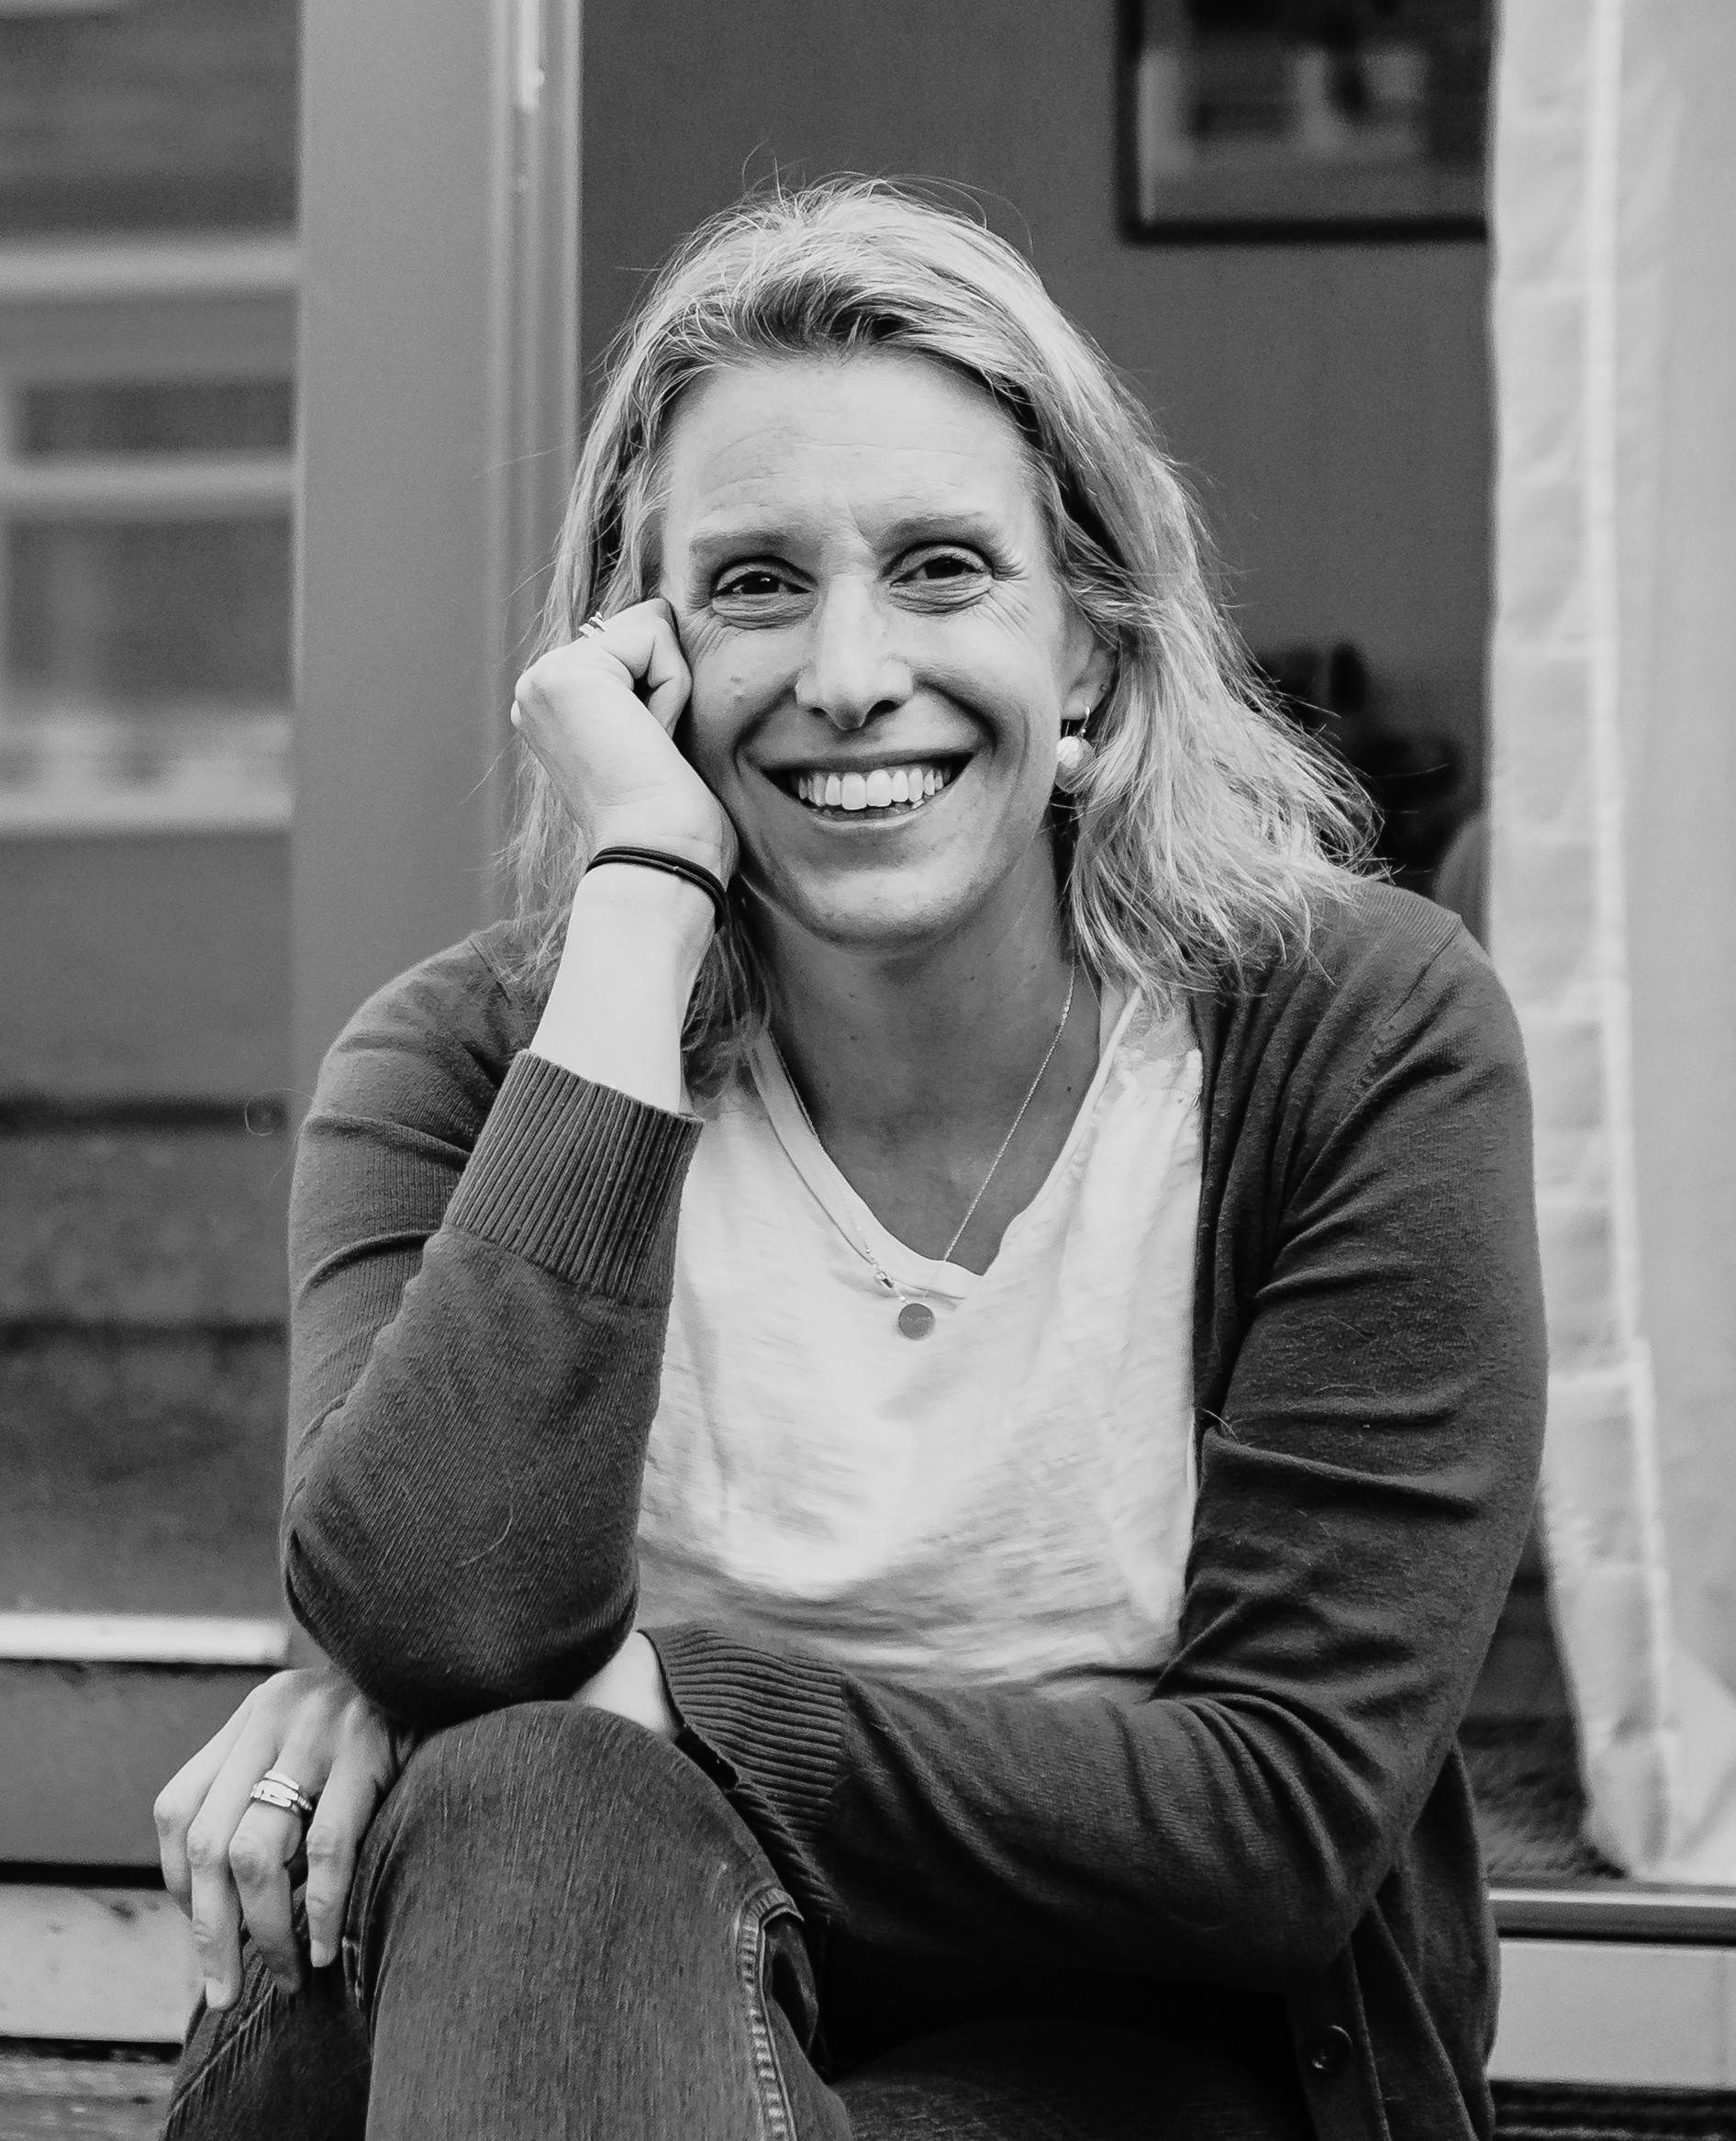

School & Beyond
Supporting Dyslexic & Neurodivergent Girls' Next Moves
A Churchill Fellowship — findings & recommendations
Dr Helen Ross
Independent researcher, consultant & specialist assessor · literacy, SEND & inclusion

Slide 2

Why this matters to me
I was identified as dyslexic at 17 — I could read the words on the page but had no idea what I'd just read.
ADHD came much later, in 2024, after a lifetime of a “goldfish brain” and very big feelings.
Both explained so much. But they arrived late, and only after real distress along the way.
“I felt really stupid at school. I do not want other people to have that same experience.”
Dr Helen Ross
2

Slide 3

Girls are the ‘so-what’ factor
80%
63%
14.9%
of dyslexic people leave school with no formal diagnosis
rise in autism diagnoses across the UK between 2023 and 2026
of women screen positive for ADHD — vs 12.4% of men (self-ID)
Without the right support, too many girls become a shell of who they could be. This project is about building things better — so they can be their best selves.
3

Slide 4
What I set out to explore
1
What skills do neurodivergent young people need as they move beyond school?
2
What pathways exist after compulsory schooling — and how do they actually work?
3
What programmes are in place to support neurodivergent learners after school?
4
How, and when, should we start building these skills?
4

Slide 5
Where I went — and why
Melbourne / Victoria · AUS
Tasmania · AUS
A deliberately flexible system: vocational and applied learning built into the Victorian Certificate of Education, valued on a par with academic routes.
A hub of collaboration — University of Tasmania, Square Pegs and the Code Read Dyslexia Network working across policy, practice and community.
San Antonio, TX · USA
Jacksonville Beach, FL · USA
Programmes building communication and independence for young people with complex needs, including the Morris Center.
Applied, student-led settings such as Acton Academy, where young people practise agency and decision-making every day.
5

Slide 6
How I worked
1
Data building, not data ‘gathering’
A qualitative, social-science approach — observations, interviews and conversations that centre people's own experiences.
2
Real settings, real practice
Schools, colleges and workplaces including Acton Academy, the Morris Center, TAFE, and various Tasmanian organisations.
3
Ethics first
Every contribution opt-in, voluntary and confidential, with a clear right to withdraw.
6

Slide 7
What I found
Four threads ran through every setting I visited.
7

Slide 8
Finding 01
Success is not a single destination
Qualifications, employment and university still matter — but they are routes towards a good life, not ends in themselves.
“Many pathways to success”: vocational and applied routes are not lesser choices.
Success is better understood as meaningful progress from a young person's own starting point.
In Florida, a student arrived unable to speak. I noted (field notes):
“His communication has opened up as a result of the programme.”
A profound achievement — and one that would be invisible in most conventional measures of success.
8

Slide 9
Finding 02
The disconnect: what we measure vs what matters
What education measures
What young people & employers value
Exam results & attainment
University progression
Destinations data
Communication & collaboration
Problem-solving & initiative
Self-management & flexibility
Knowing when to ask for help
These skills aren't separate from academic learning — they are how young people access and apply it.
9

Slide 10
Finding 03
Self-advocacy & autonomy — the core thread
More than asking for help: understanding your own strengths, needs and rights — with the confidence and language to speak up.
Girls often mask difficulty, having been praised for being quiet, compliant and organised — so asking for help can feel exposing.
Autonomy is not managing alone. It's making an informed choice to use support, tools or adjustments.
Preparation must build agency rather than dependence — successful adulthood is interdependent, not unsupported.
10

Slide 11
It has to start earlier than we think
Preparation for adulthood cannot begin at 16 or 18.
11

Slide 12
Building skills across the whole journey
1
2
3
4
Early years & primary
Secondary
FE & university
World of work
→
→
→
Build agency from the very beginning — choices, reflection and problem-solving.
Where coping is too often mistaken for thriving, especially for girls who mask.
Navigating choice and change — not just new content, but new independence.
Skills that don't transfer automatically: self-advocacy, organisation, workplace norms.
12

Slide 13
What needs to happen
Organised by how fast change can happen — and who is responsible for it.
13

Slide 14
Shared responsibility, three horizons
1
2
3
LONG-TERM & STRUCTURAL
MID & SHORT-TERM
HERE & NOW
Government, policymakers, funders & employers
Schools, colleges, universities & workplaces
Everyone — today
Reform, funding and national entitlements.
Practice, programmes and staff development.
Practical steps, often at little or no cost.
Young people should build self-advocacy — but the systems around them must be willing to listen and respond.
14

Slide 15
HORIZON 1
Long-term & structural
Government, funders & employers
Reform how schools are judged — beyond exams and university destinations to wellbeing and individual progress.
Establish parity of ‘esteem’ for academic, vocational and applied pathways.
Create a national entitlement to early, personalised transition planning for young people with SEND.
Improve screening sensitive to masking, plus faster diagnosis and a more responsive Access to Work.
Strengthen teacher and employer training — and co-produce services with neurodivergent young women.
15

Slide 16
HORIZON 2
Mid & short-term — practice & training
Schools, colleges, universities & workplaces
Structured transition and skills programmes: communication, self-advocacy, organisation, teamwork.
Flexible teaching and assessment; applied and vocational routes alongside academic ones.
High-quality resources free at the point of use — not dependent on income or a diagnosis.
A named transition lead, and portable, student-led support profiles that belong to the learner.
Stronger partnerships between education providers and employers.
16

Slide 17
HORIZON 3
Here & now — start today
Everyone, often at little or no cost
Warm referrals and clear signposting — an introduction, not another webpage.
A ready menu of quick adjustments; quiet spaces to step away, regulate and return.
One-page, person-led profiles so no one has to keep re-explaining themselves.
Make expectations explicit, and recognise a broader range of achievement.
“Ask before assuming.”
The simplest way to protect dignity, autonomy and participation.
17

Slide 18



Their best selves
“We need to build things better for our girls, so they can be their best selves.”
Free, at-point-of-use resources for girls and young women are on the way — and the analysis continues to grow over the coming years. With thanks to the Churchill Fellowship, and to everyone who shared their experiences.
+44 7541 557827
helen@helensplace.co.uk
churchillfellowship.org / helen-ross
Dr Helen Ross · independent researcher, consultant & specialist assessor

